Slide 1
COMPUTER ORGANIZATION AND ARCHITECTURE
Prof. (Dr.) Rijwan Khan
Department of Computer Science and Engineering
School of Computing
Galgotias University, G. B. Nagar

Slide 2
Computer Organization & Architecture
E2UC505T
By
Prof. (Dr.) Rijwan Khan
Department of Computer Science and Engineering
School of Computing, Galgotias Univesity, G.B. Nagar
Ph: 9891676180. email: rijwan.khan@galgotiasuniversity.edu.in

Slide 3
Course Code: E2UC505T Course Name: Computer Organization and Architecture
Introduction: Functional units of digital system and their interconnections, buses, bus architecture, types of buses and bus arbitration. Register, bus and memory transfer, Processor organization, general registers organization, stack organization and addressing modes.
Arithmetic and logic unit: Look ahead carries adders, Fixed point representations and Arithmetic Operations: Addition and Subtraction, Multiplication: Signed operand multiplication, Booth’s algorithm and array multiplier. Division and logic operations. Floating point representations and arithmetic, IEEE Standard for Floating Point Numbers.
Control Unit: Instruction types, formats, instruction cycles and sub cycles (fetch and execute etc), micro-operations, execution of a complete instruction. Program Control, Reduced Instruction Set Computer, Pipelining, Hardwired and Microprogrammed control unit.
Input / Output: Peripheral devices, I/O interface, I/O ports, Interrupts: interrupt hardware, types of interrupts and exceptions. Modes of Data Transfer: Programmed I/O, interrupt initiated I/O and Direct Memory Access., I/O channels and processors. Serial Communication: Synchronous & asynchronous communication, standard communication interfaces.
Memory: Basic concept and hierarchy, semiconductor RAM memories, 2D & 2 1/2D memory organization. ROM memories. Cache memories: concept and design issues performance, address mapping and replacement Auxiliary memories: magnetic disk, magnetic tape and optical disks Virtual memory: concept implementation.

Slide 4
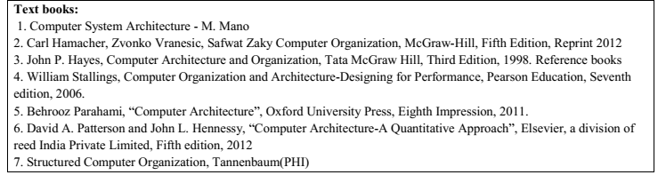
Reference Books

Slide 5
CO1 | Study of the basic structure and operation of a digital computer system
CO2 | Develop independent learning skills and be able to learn more about different computer architectures and hardware
CO3 | Learn control unit techniques and the concept of Parallel Processing
CO4 | Understanding the different ways of communicating with I/O devices and standard I/O interfaces
CO5 | Understanding the hierarchical memory system, cache memories and virtual memory
CO6 | Given a CPU organization and instruction, design a memory module and analyze its operation by interfacing with the CPU.

Slide 6
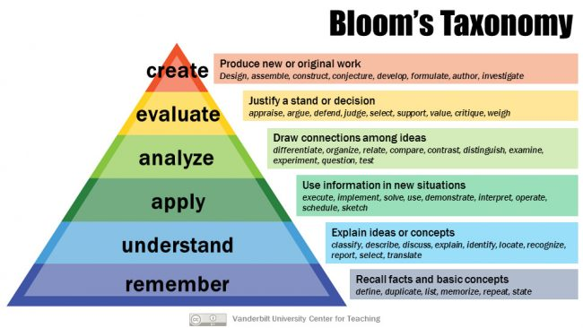
Bloom’s Taxonomy

Slide 7
What is “Computer Architecture”
Computer Architecture =
Instruction Set Architecture +
Machine Organization

Slide 8
Organization vs. Architecture
Architecture ≅ Specification
Attributes visible to the programmer
Attributes:
Instruction set
Number of bits representing data
I/O mechanism
Addressing modes used
Has direct impact on logical program execution

Slide 9
Organization vs. Architecture
Organization ≅ Implementation
Operational units and their interconnection that realizes the architecture
Attributes:
H/W details
Control signals
I/O interfaces
Memory technology used

Slide 10
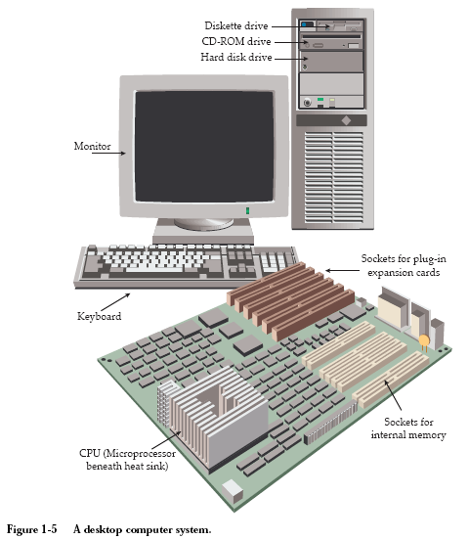

Slide 11
Function
All computer functions are:
Data processing
Data storage
Data movement
Control

Slide 12
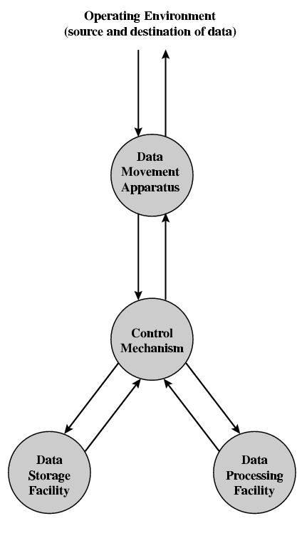
Functional View

Slide 13
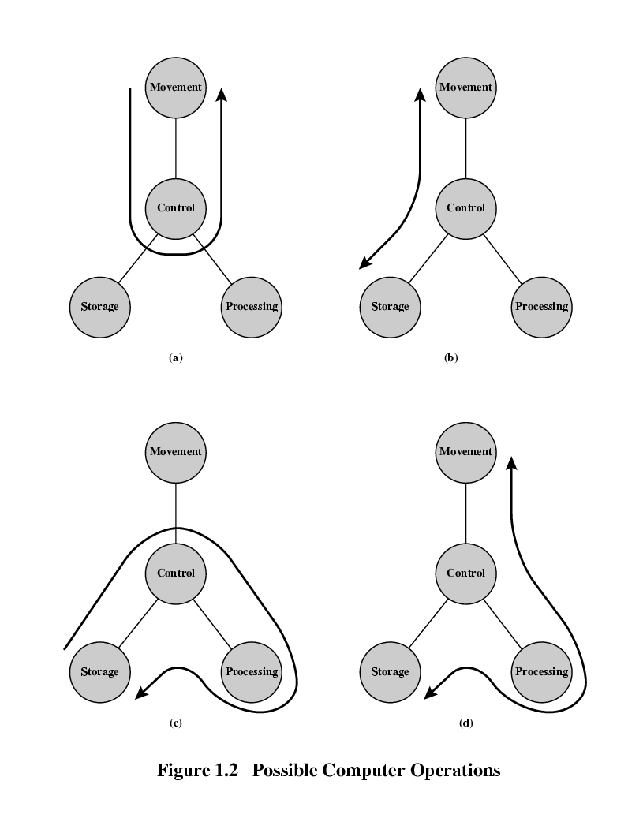
Operations (a) Data movement

Slide 14
Operations (b) Storage

Slide 15
Operation (c) Processing from/to storage

Slide 16
Operation (d) Processing from storage to I/O

Slide 17
Structure - Top Level
Peripherals
Computer
Central
Processing
Unit
Main
Memory
Computer
Systems
Interconnection
Input
Output
Communication
lines

Slide 18
Structure - The CPU
CPU
Computer
Arithmetic
and
Login Unit
I/O
Registers
System
Bus
CPU
Internal CPU
Interconnection
Memory
Control
Unit

Slide 19
Structure - The Control Unit
Control Unit
CPU
ALU
Sequencing
Logic
Internal
Bus
Control
Unit
Control Unit
Registers and
Decoders
Registers
Control
Memory

Slide 20
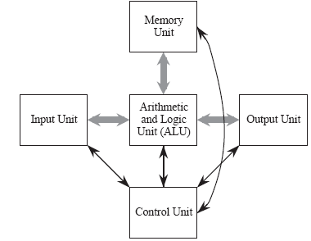
The Von Neumann Model
The Input Unit provides instructions and data to the system, which are subsequently stored in the Memory Unit . The instructions and data are processed by the Arithmetic and Logic Unit (ALU) under the direction of the Control Unit . The results are sent to the Output Unit . The ALU and control unit are frequently referred to collectively as the central processing unit (CPU)
The stored program is the most important aspect of the Von Neumann model. A program is stored in the computer’s memory along with the data to be processed.

Slide 21
The System Bus Model
This model partitions a computer system into three subunits: CPU, Memory, and Input/Output (I/O). This refinement of the von Neumann model combines the ALU and the control unit into one functional unit, the CPU. The input and output units are also combined into a single I/O unit.
Most important to the system bus model, the communications among the components are by means of a shared pathway called the system bus , which is made up of the data bus (which carries the information being transmitted), the address bus (which identifies where the information is being sent), and the control bus (which describes aspects of how the information is being sent, and in what manner).

